Slide 1
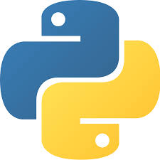
FDP on “Artificial Intelligence and Machine Learning using python”
Basics of Python
By
Dr. Raju Pal & Dr. Himanshu
Computer Science & Engineering Department,
Jaypee Institute of Information Technology,
Noida, Uttar Pradesh
10 Aug 2020

Slide 2
Outline
What is Python?
Download & Install Anaconda for Python
Learn Basics of Python
Conditional Statements in Python
Loops of Python
Libraries in Python

Slide 3
What’s Python ?
General purpose programming language
Named after Monty Python-British comedy group
Used to do things from testing microchips at Intel
Used to powering Instagram
building video games ,popular in IoT, Data Science ,Big Data, AI and so on….
Followed by millions of users worldwide

Slide 4
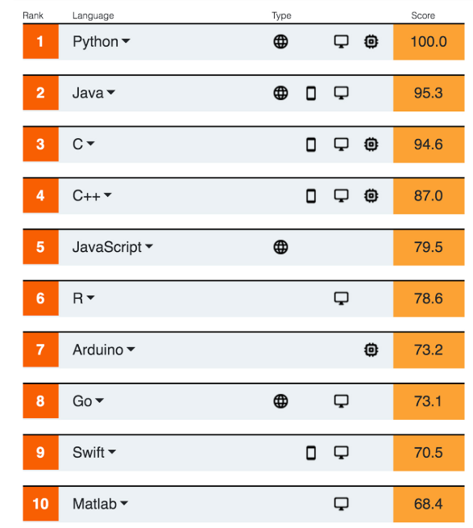
Why Python?
Image source: IEEE Spectrum Jul 2020

Slide 5
Why Python?
Fast, lower learning-curve, user-friendly
Plays well with others
Runs everywhere
Known for rich-ecosystem & utilities
Major advantage is its breadth
Has thousands of third-party modules and libraries
Libraries/frameworks are mature and tested for 10+ years

Slide 6
Python Tools For Scientific Community

Slide 7
Who Uses Python?
Google makes extensive use of Python in its web search system
Intel, Cisco, Hewlett-Packard, Seagate, Qualcomm, and IBM use Python for hardware testing
YouTube video sharing service is largely written in Python
NASA uses Python for hardware testing and satellite launching
...the list goes on...

Slide 8


Download Python
Download and Install Python
1. Go to Google and search “python”
www.python.org
2. Go to Google and search “Anaconda”
www.anaconda.com

Slide 9



Python IDE
1. Python default IDE is ‘IDLE”
2. Spyder
3. Jupyter Notebook
4. PyCharm
5. ……… Many More

Slide 10




Python Online IDE
Google Colab
IDEOne
Programiz
OnlineGDB
……. Many More

Slide 11
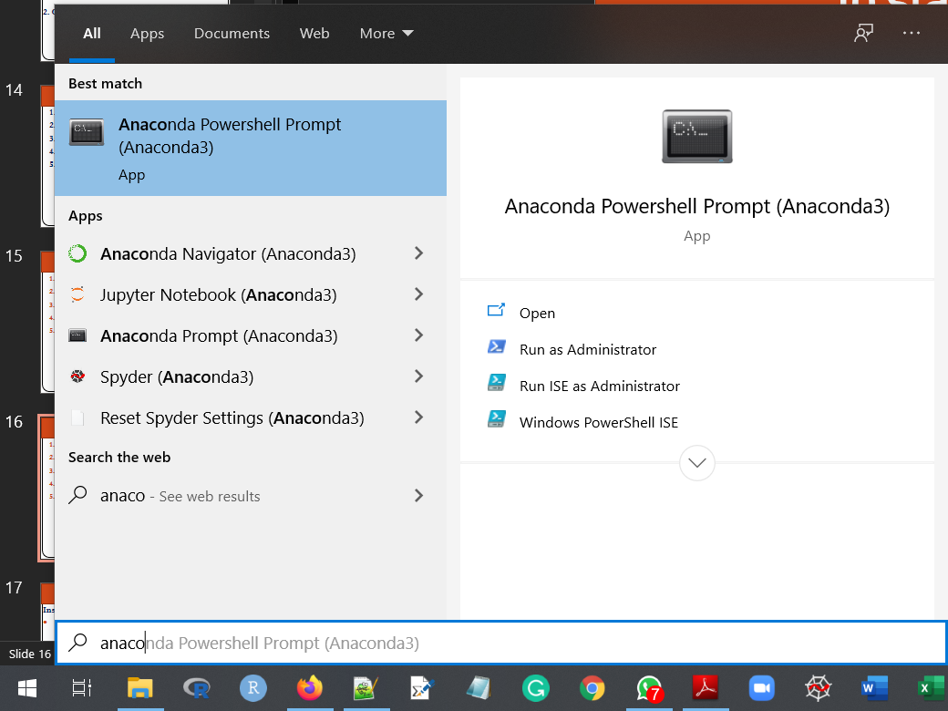
To start Python IDE
Install Anaconda (https://docs.anaconda.com/anaconda/install/windows/)
Open “Anaconda Prompt”
Start → Anaconda
Cheat Sheet : shorturl.at/luKM9

Slide 12

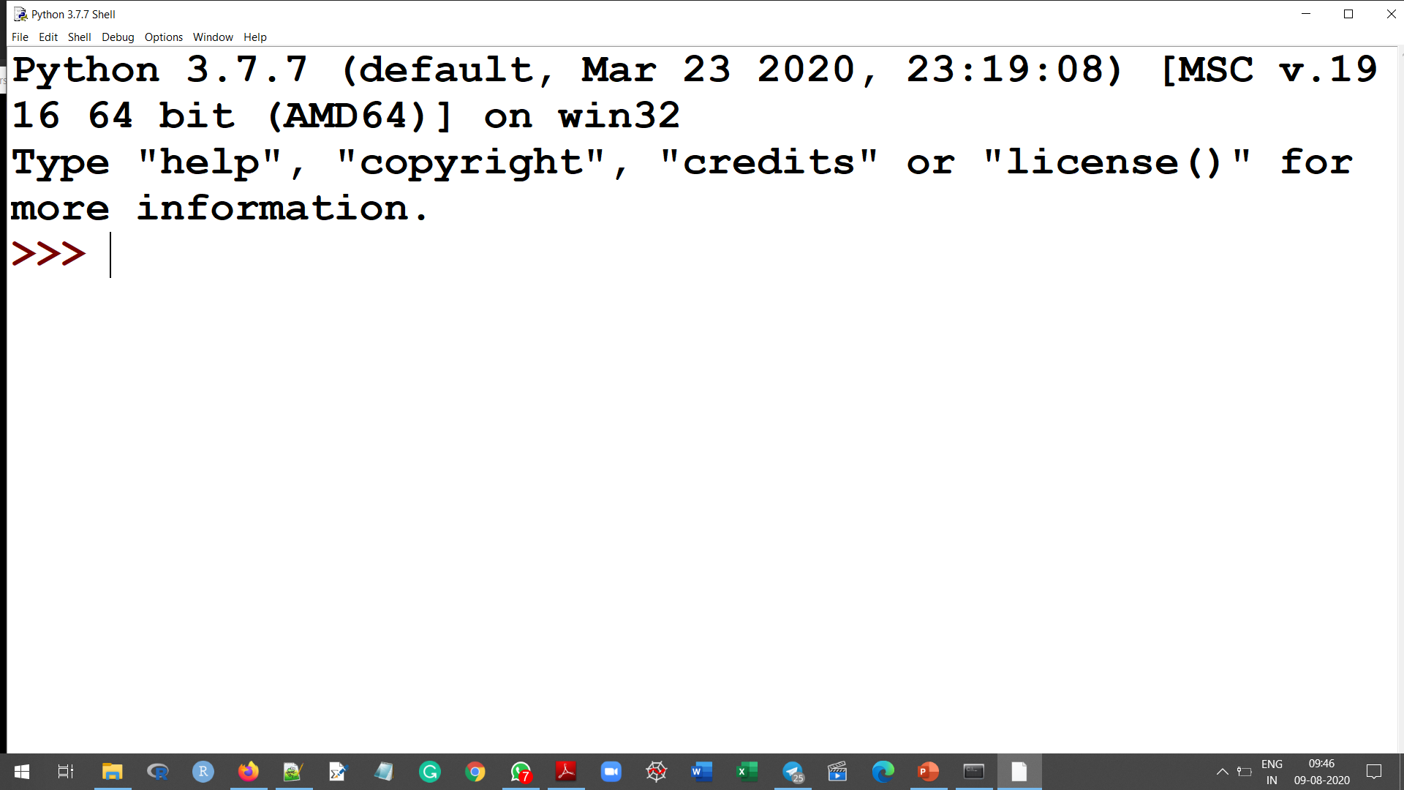
To start Python IDE
Write on cmd line → idle

Slide 13
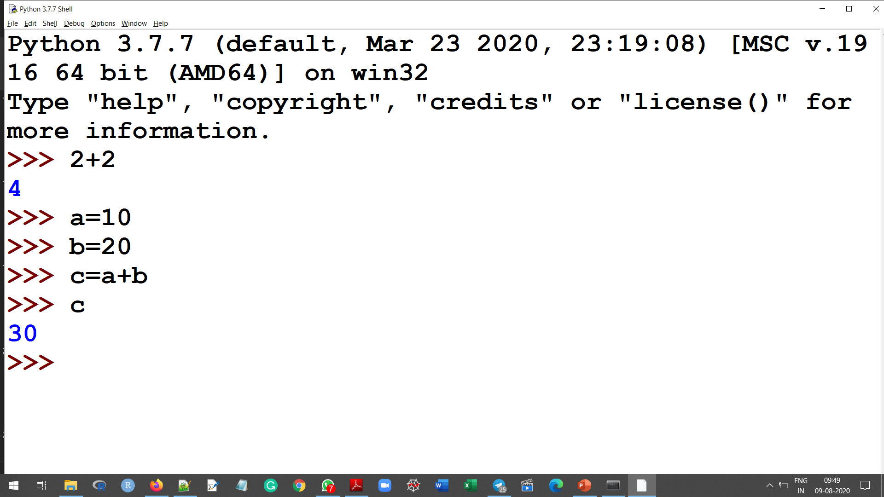
Working with Python IDE

Slide 14
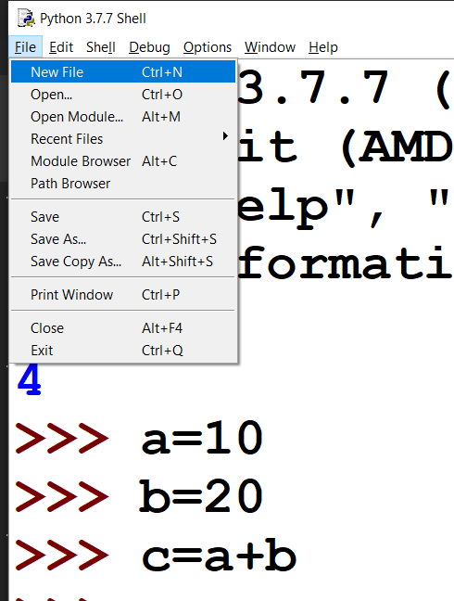
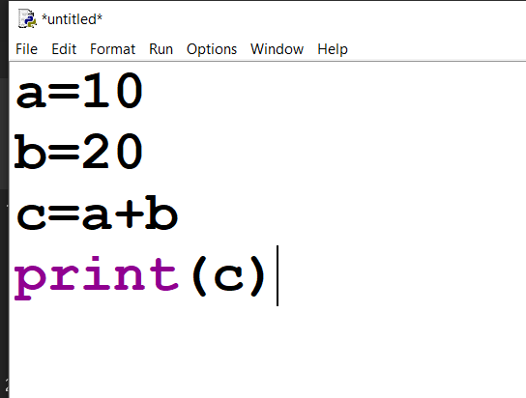
To start Python IDE
Click on File → New File
Write first python program in the file
Save and run (F5)

Slide 15
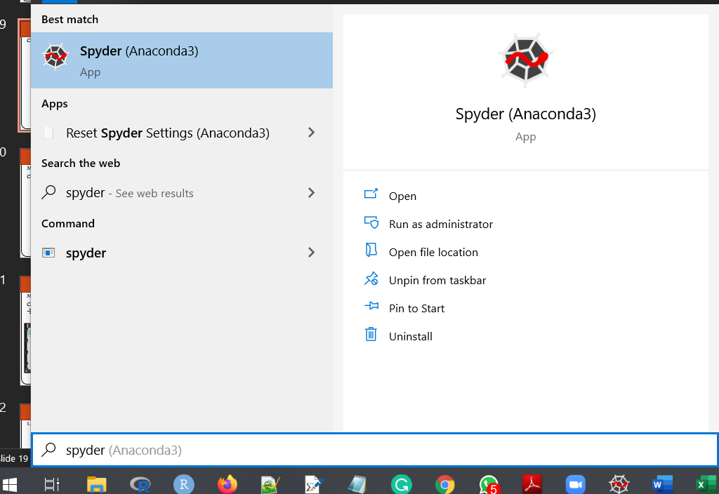
Working with Spyder
Click on Start and Write → Spyder

Slide 16
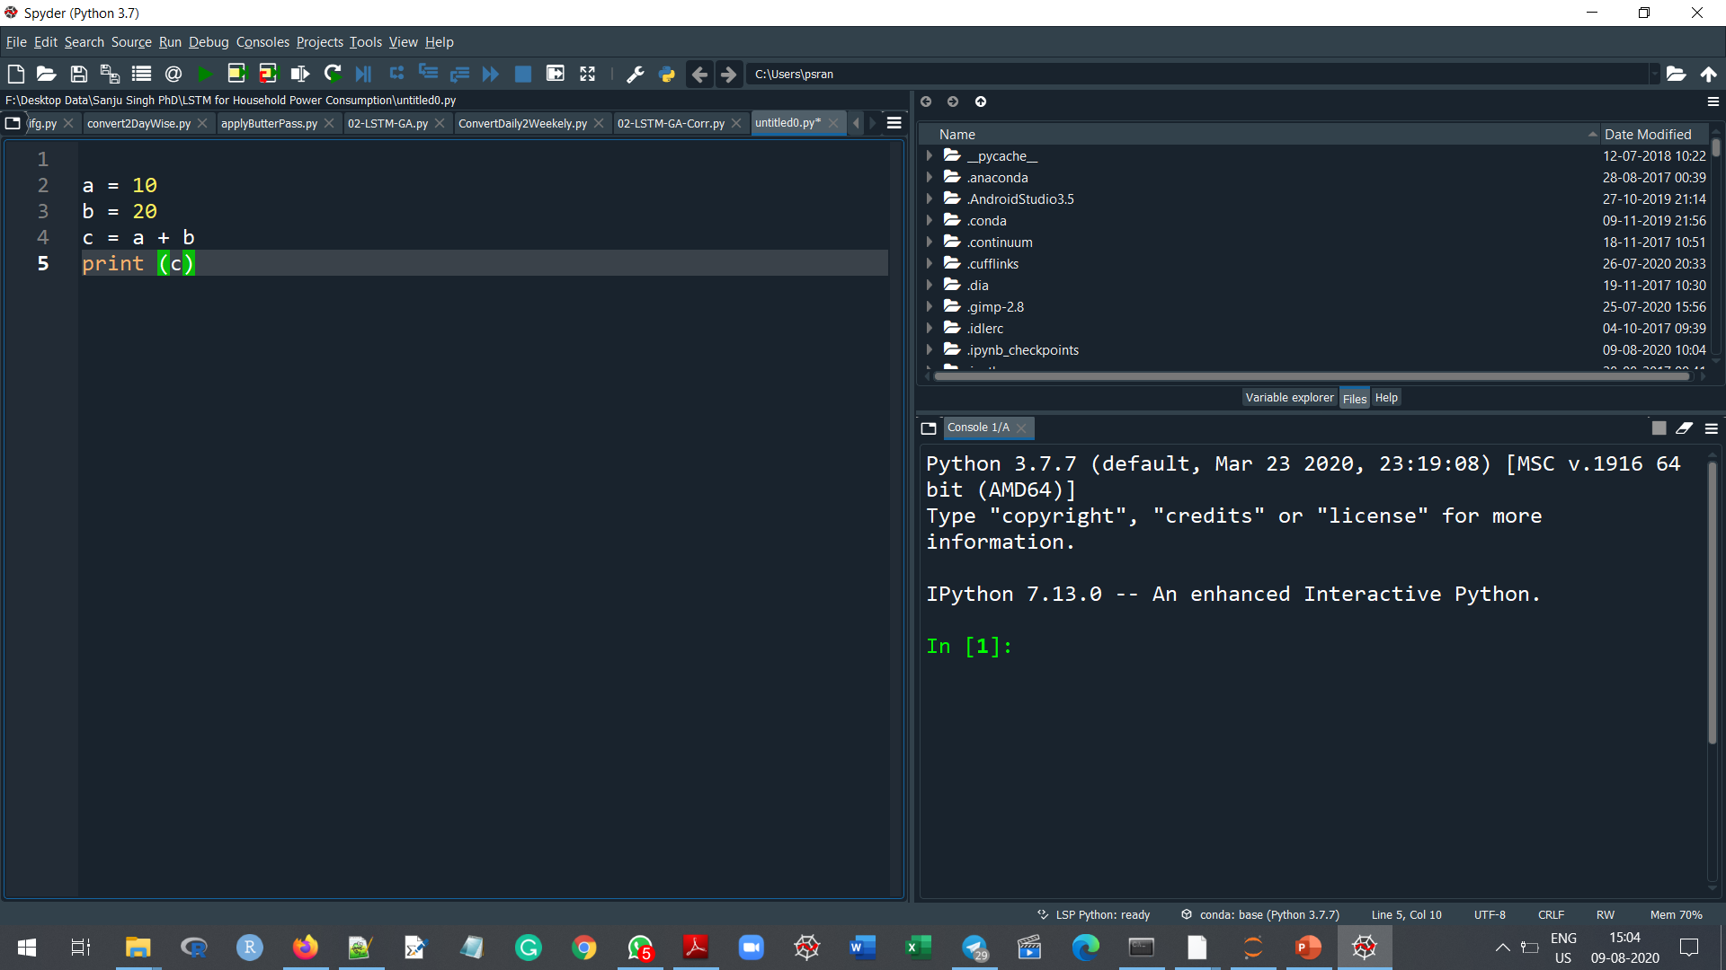
Working with Spyder
Click on Start and Write → Spyder
Write python program in file, save and run (F5)

Slide 17
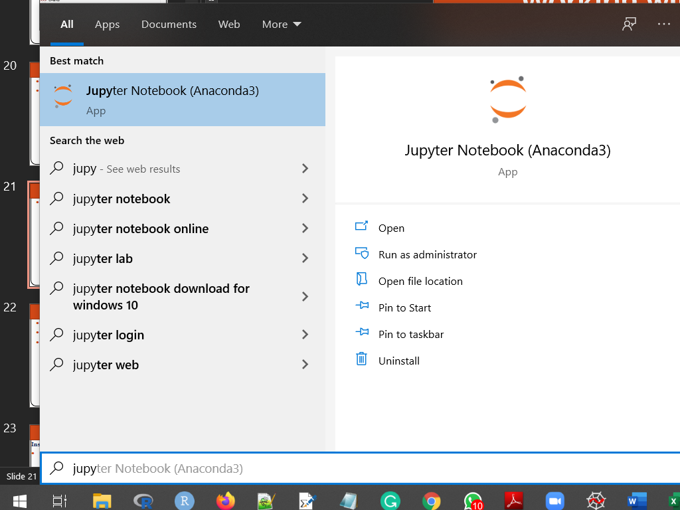
Working with Jupyter Notebook
Open Jupyter → Method 1
Click on Start and Write → Jupyter Notebook

Slide 18
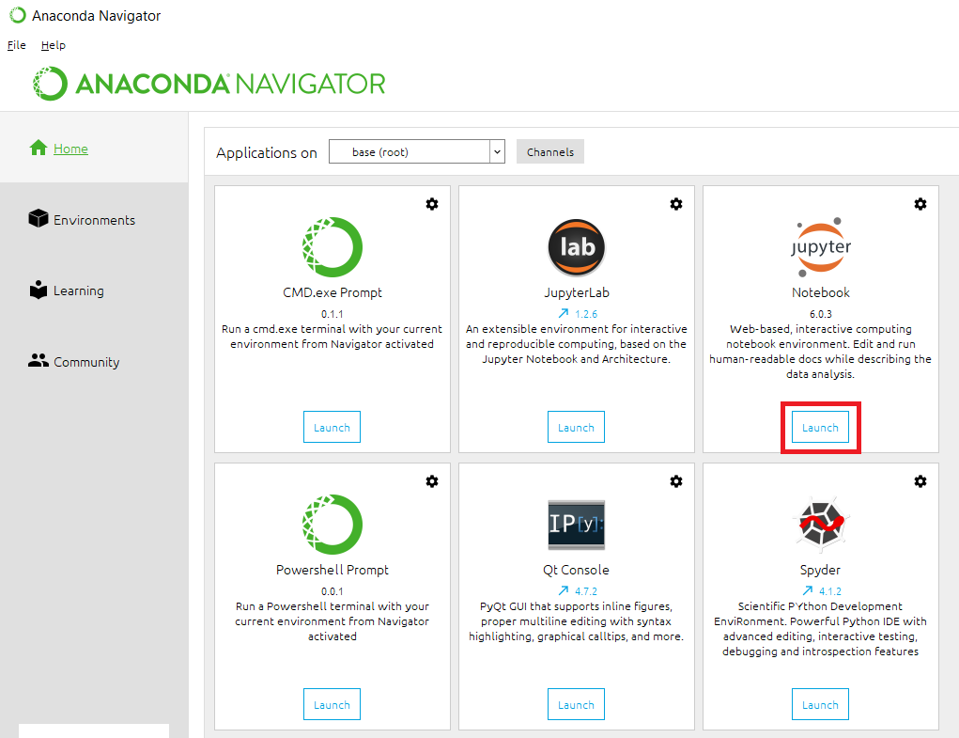
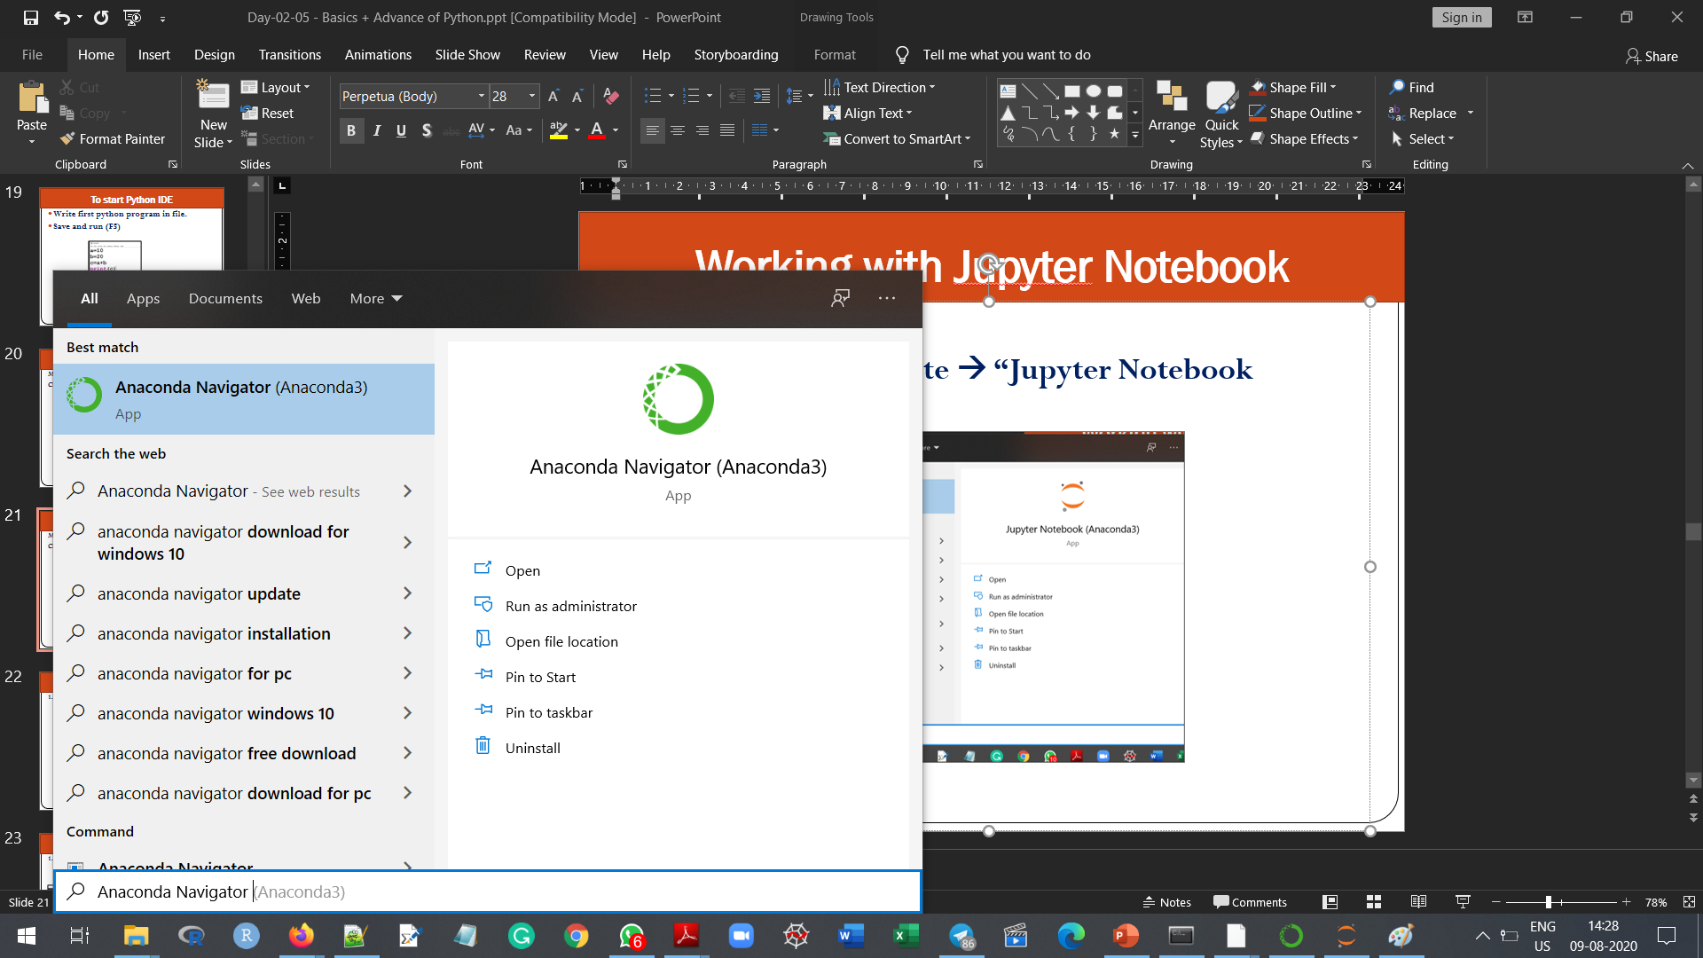
Working with Jupyter Notebook
Open Jupyter → Method 2
Click on Start and Write → Anaconda Navigator
→ Launch Jupytor

Slide 19
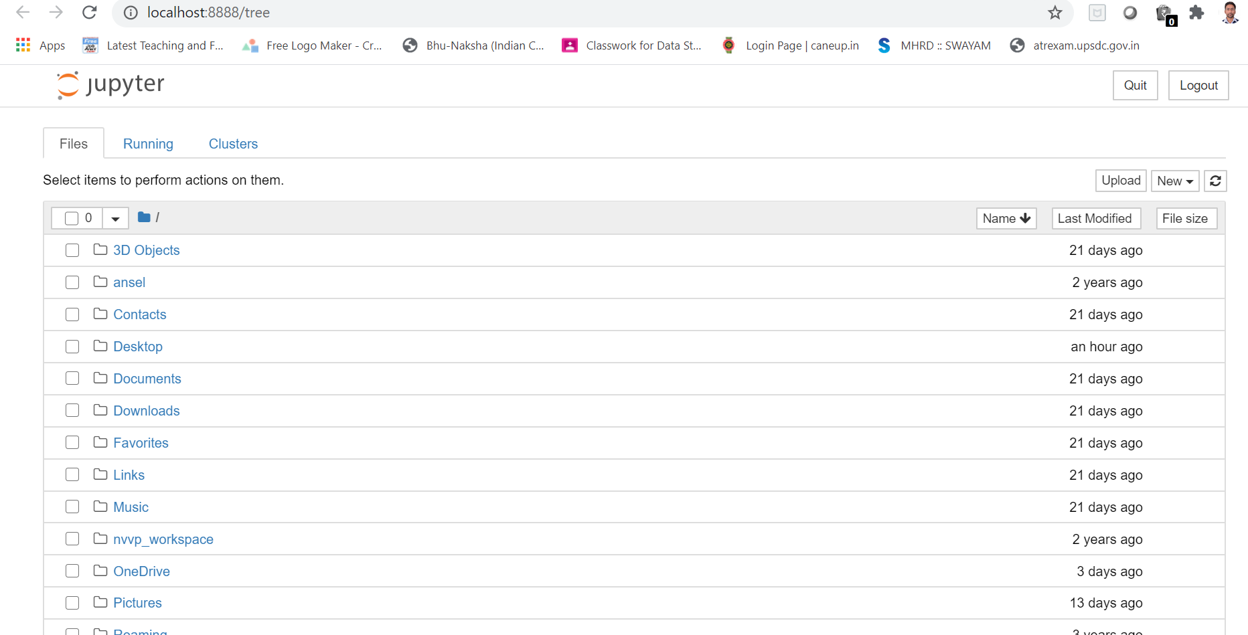
Working with Jupyter Notebook
1. Click on Start and Write → Jupyter Notebook
Jupyter will open in Brower

Slide 20
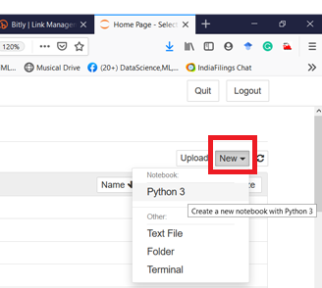
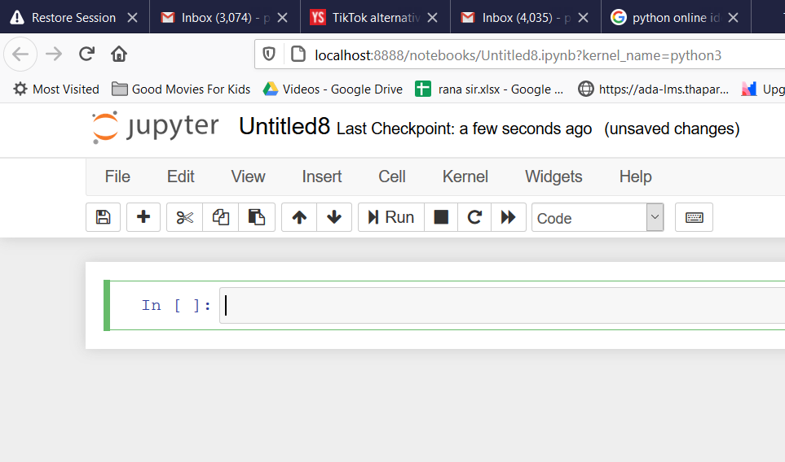
Working with Jupyter Notebook
1. Click on Start and Write → Jupyter Notebook
Jupyter will open in Brower
Click on → New → Python 2/3

Slide 21
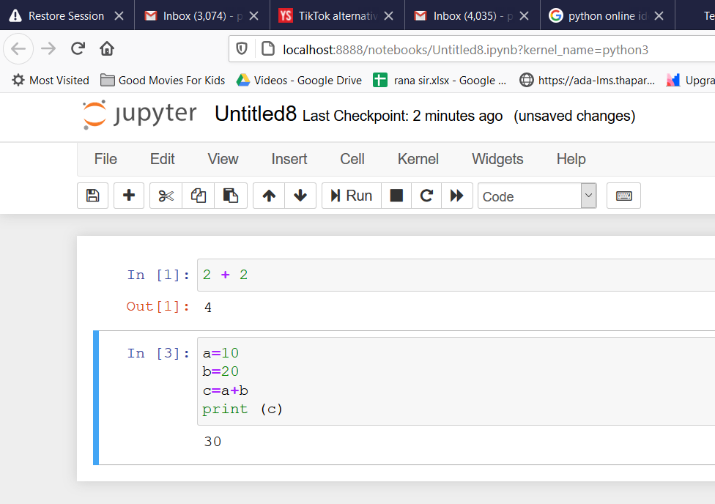
Working with Jupyter Notebook
To execute cell → press “ctrl + enter”

Slide 22
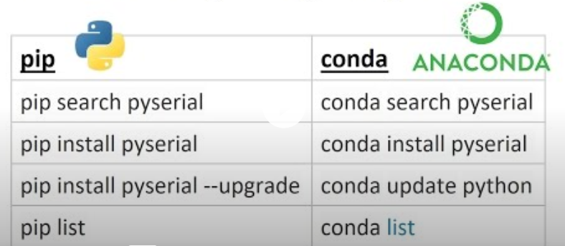
Install Python Package
Two ways to install → pip or conda
Go to Anaconda Prompt and write →
pip install <packageName>
conda install <packageName>

Slide 23
Thanks
Learning by Doing
raju3131.pal@gmail.com

